Slide 1
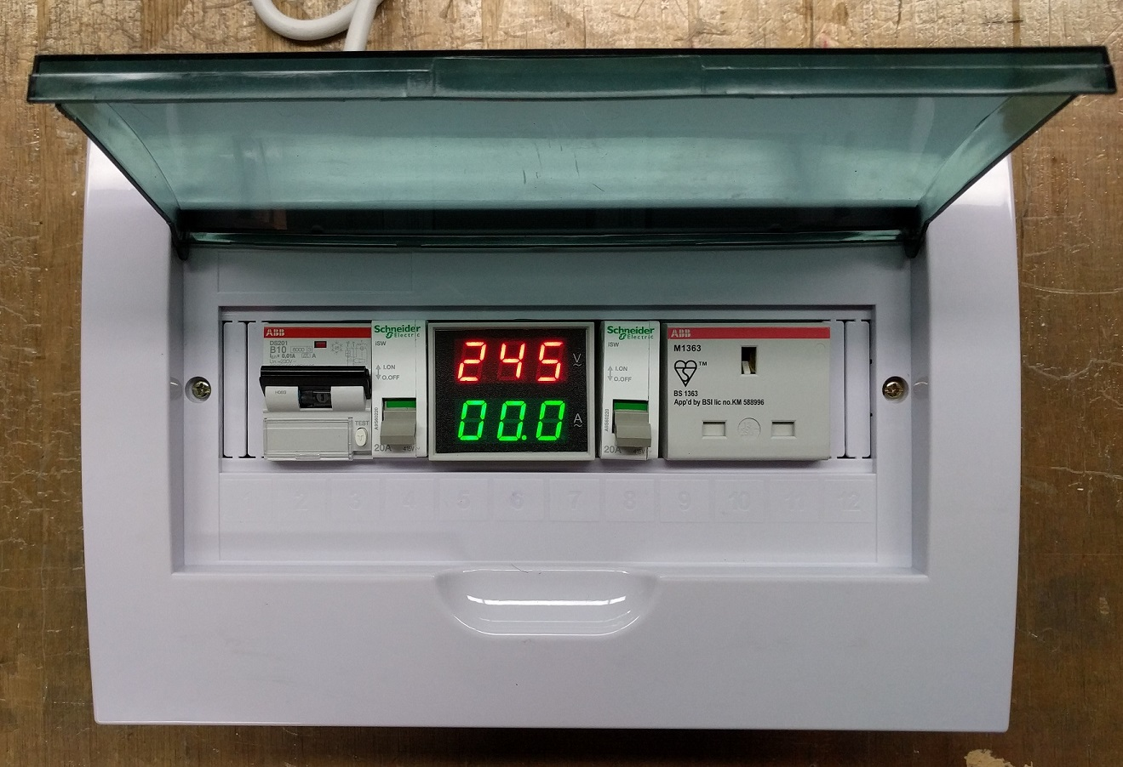
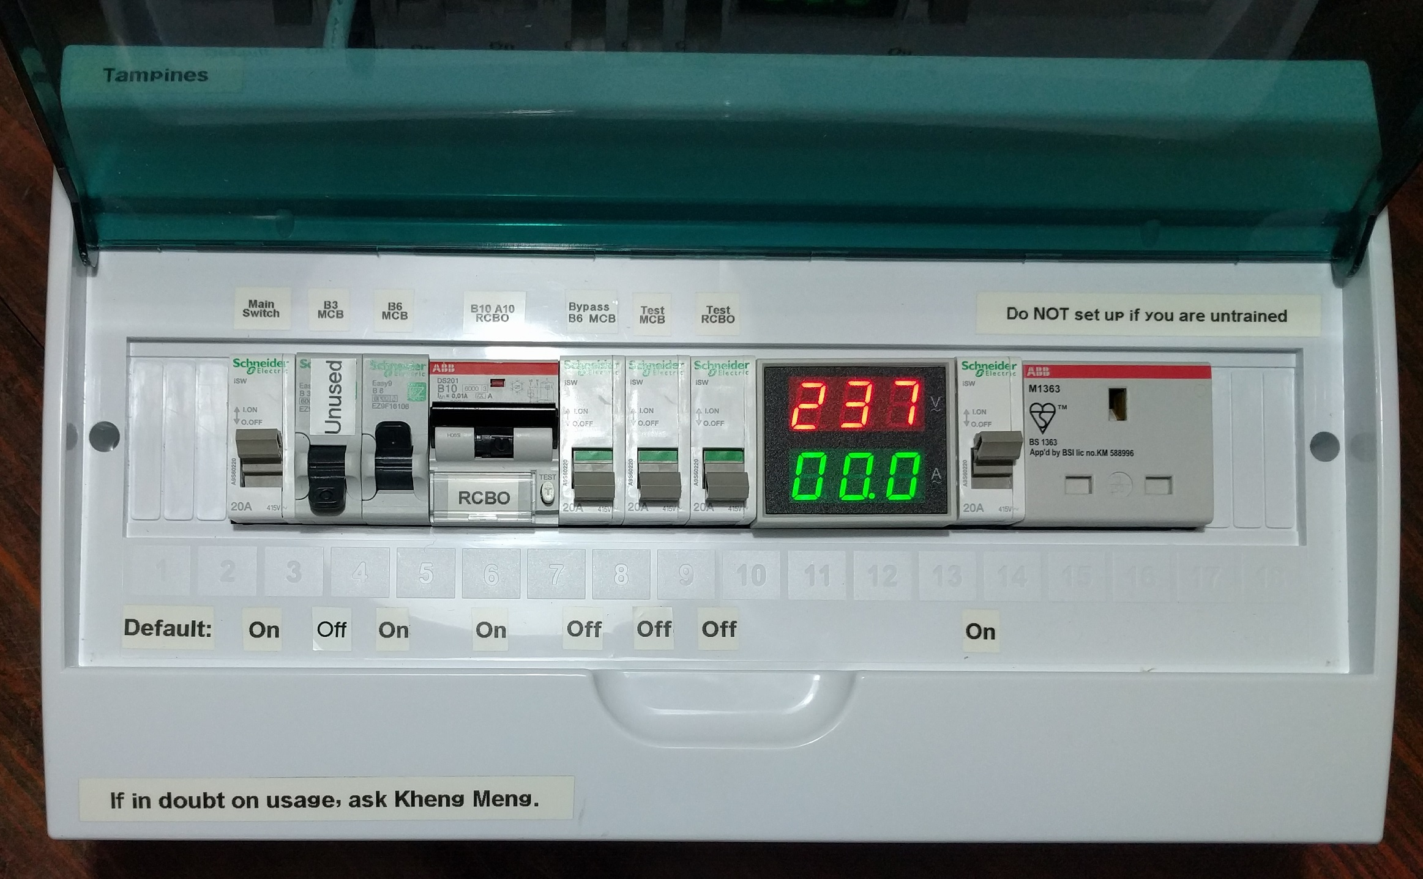
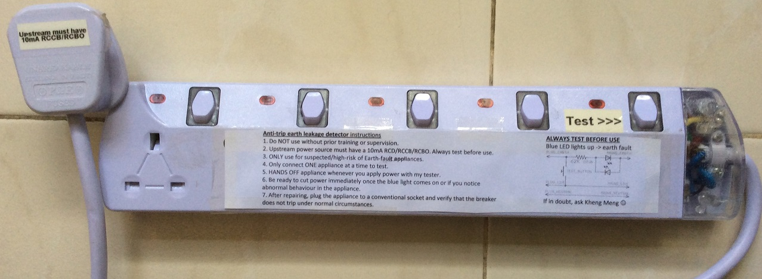
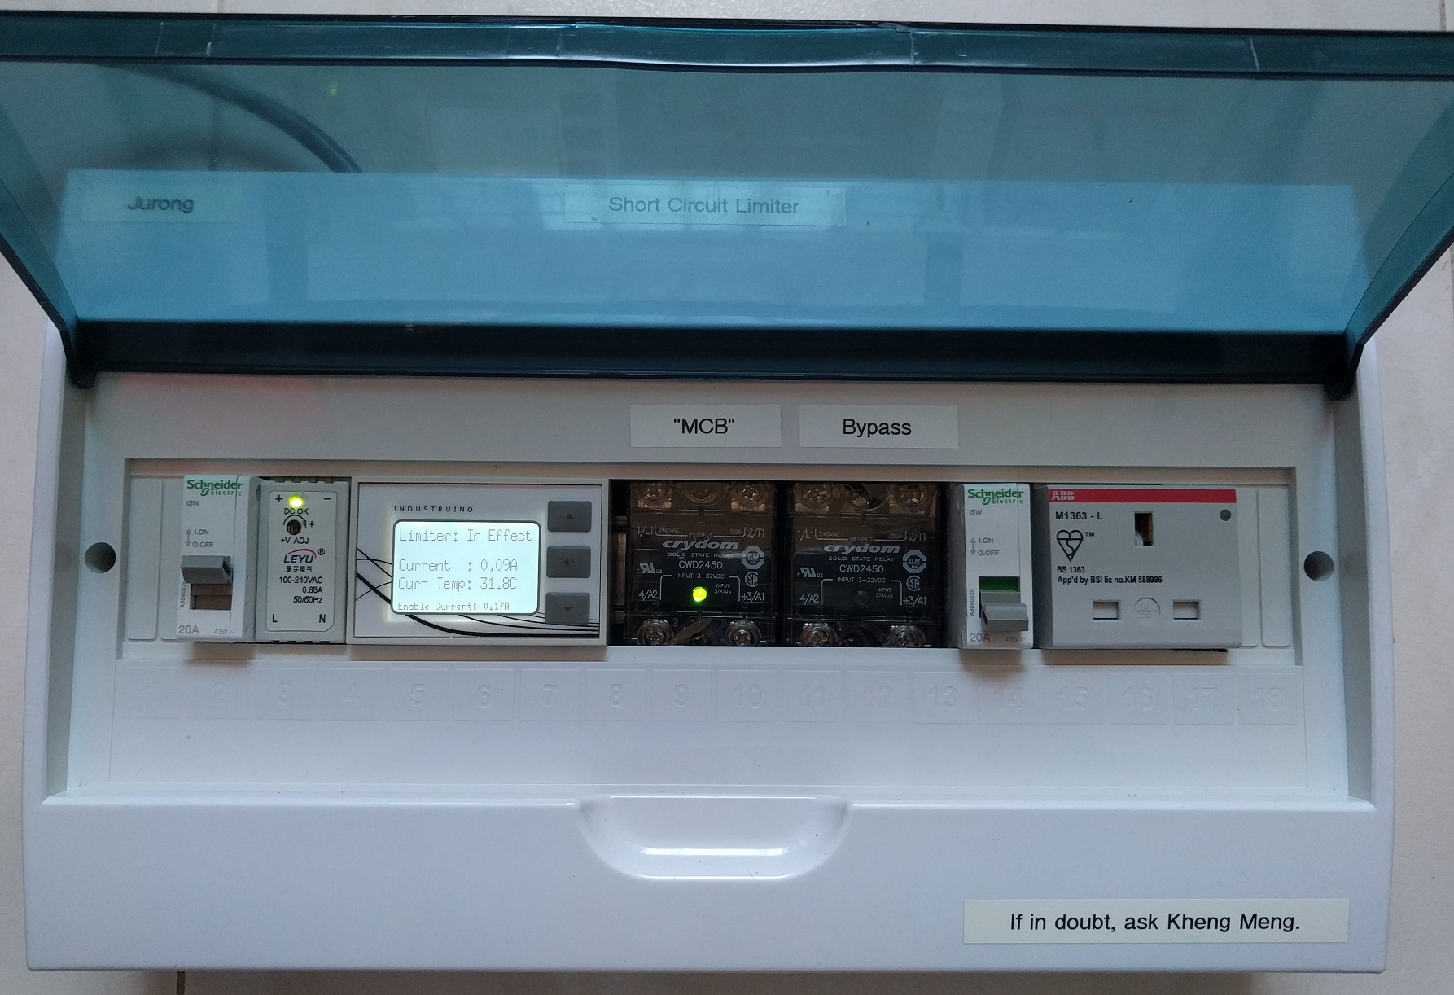
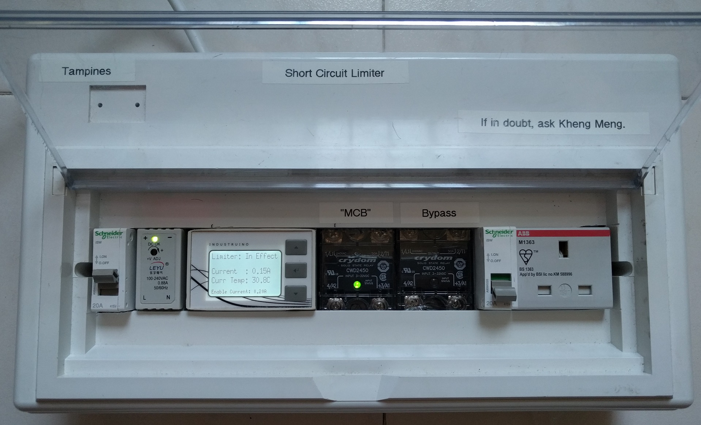
Repair Kopitiam Circuit Breaker Training
By: Yeo Kheng Meng (yeokm1@gmail.com)
https://github.com/yeokm1/repair-kopitiam-training-and-equipment
http://yeokhengmeng.com/2016/05/repair-kopitiam-speciality-electrical-tools/
http://yeokhengmeng.com/2017/07/repair-kopitiam-specialty-electrical-tools-part-2-short-circuit-limiter/
For Repair Kopitiam Training

Slide 2
Agenda
Knowledge Recap
Problems
Solution
Electrocution case study

Slide 3
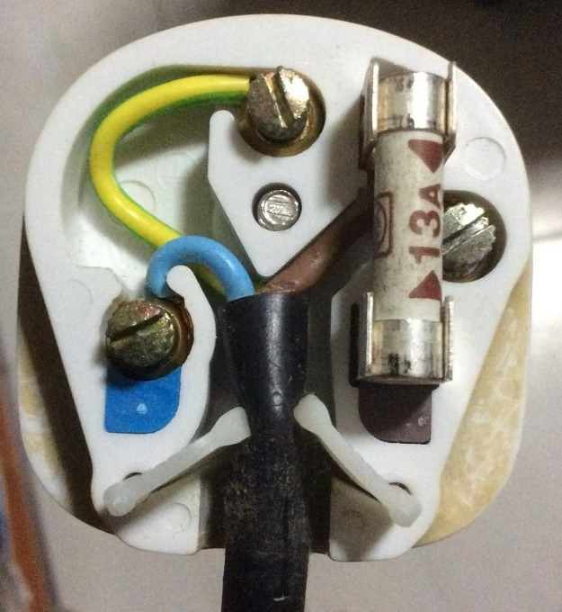
Inside the 3-pin mains plug (BS1363)
Earth
Yellow and Green
Connects to appliance’s external case, protects user from electric shock
Fuse
Blows on overcurrent
Usually 13A
Live
Brown
Source of power
Neutral
Blue
Completes the circuit to generator
Tied to ground at power distribution box to ensure stable 0V

Slide 4
Earth connections: Normal operation
Kettle
Mains Live
Fuse
230V
AC ~
Mains Neutral
Mains Earth
Earth

Slide 5
Live wire touches case
X
Kettle
Mains Live
Fuse
230V
AC ~
Mains Neutral
Mains Earth
Earth

Slide 6
What if there is no Earth wire?
Kettle
Mains Live
Fuse
230V
AC ~
Mains Neutral
Earth

Slide 7
But this does not happen in practice

Slide 8
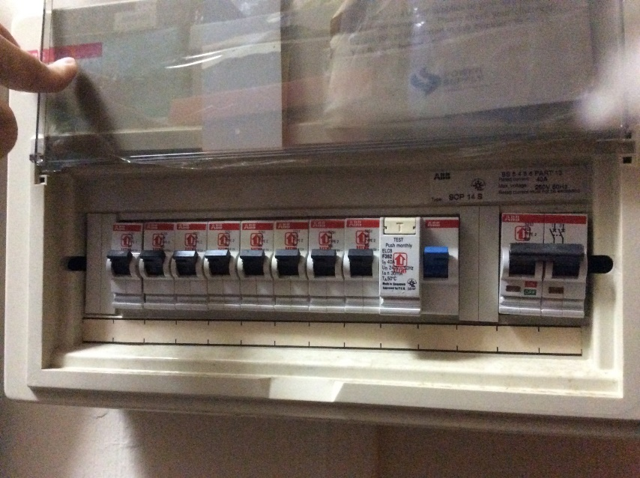
MCB + RCCB Circuit Breakers
MCB
RCCB
Residual Current Circuit Breaker (RCCB)
What it does? Breaks the circuit on earth fault
Cause: Current leakage to Earth
When?: Breaks when current difference between
(|live| - |neutral|)> 30mA threshold
Miniature Circuit Breakers (MCBs)
Breaks the circuit on overcurrent eg. short circuit

Slide 9
Circuit breaker arrangement
Mains Live
Kettle
RCCB
MCB
Fuse
230V
AC ~
Mains Neutral
Mains Earth
Earth
Residual Current Circuit Breaker (RCCB)
What it does? Breaks the circuit on earth fault
Cause: Current leakage to Earth
When?: Breaks when current difference between
|live – neutral|> 30mA threshold
Miniature Circuit Breakers (MCBs)
Breaks the circuit on overcurrent eg. short circuit
9

Slide 10
Residual Current Circuit Breaker with Overcurrent Protection (RCBO)
Mains Live
Kettle
RCBO
Fuse
230V
AC ~
Mains Neutral
Mains Earth
Earth
RCBO = RCCB + MCB

Slide 11
Blackout recovery procedure
Why? Overcurrent or earth-leakage detected
Turn off every electrical device
Flip breaker to ON
Turn on ONE device at a time. If it trips again, you have found your spoilt device.
Prioritise simple devices like lamps/ovens.
Computers and refrigerators are sensitive to repeated power cycles.
Unplug that spoilt appliance
Flip breaker back on.

Slide 12
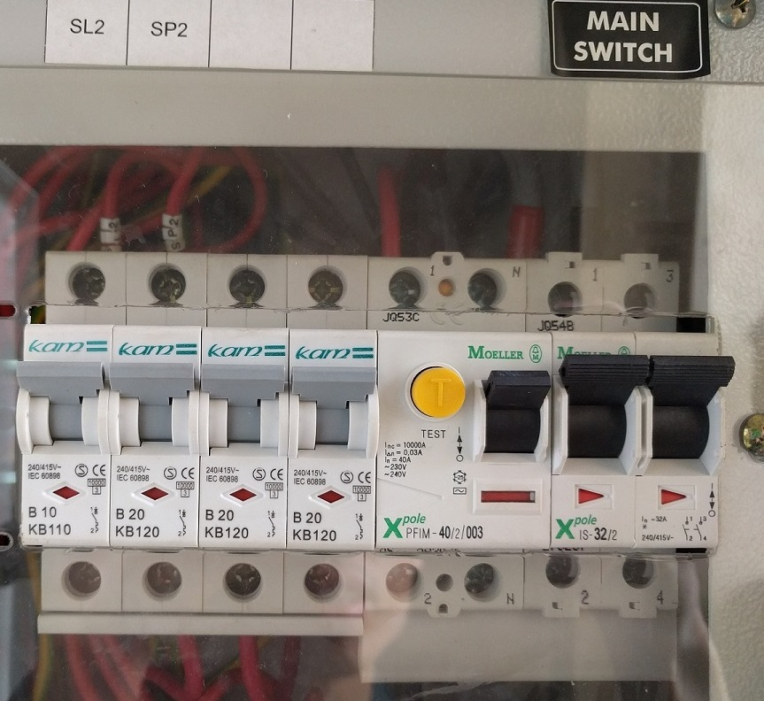
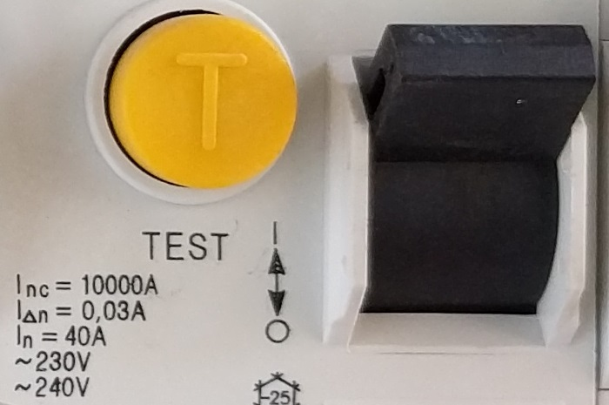
Problem 1: Safety
Typical I_{△n} = 30ma threshold for earth leakage which is still dangerous
Balance between safety and nuisance trips
But RK always deals with high-risk faulty appliances…

Slide 13
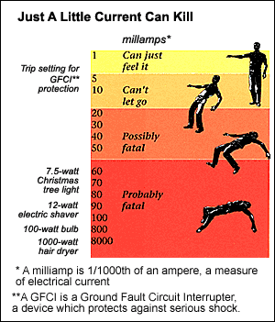
GFCI = RCCB
https://www.quora.com/How-much-voltage-is-dangerous-for-humans/answer/Mukund-Todmal
It is not voltage but the current flowing through body will decide lethality.

Slide 14
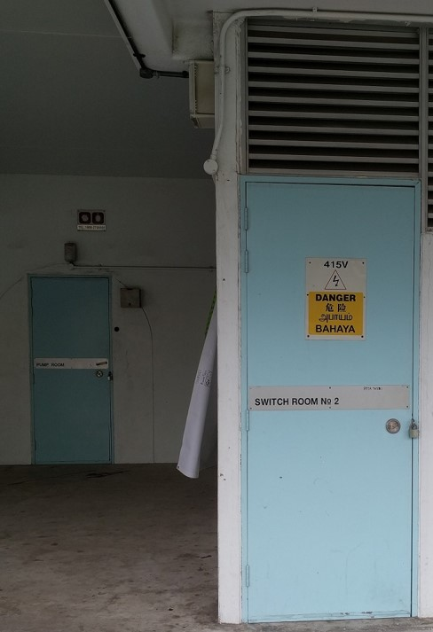
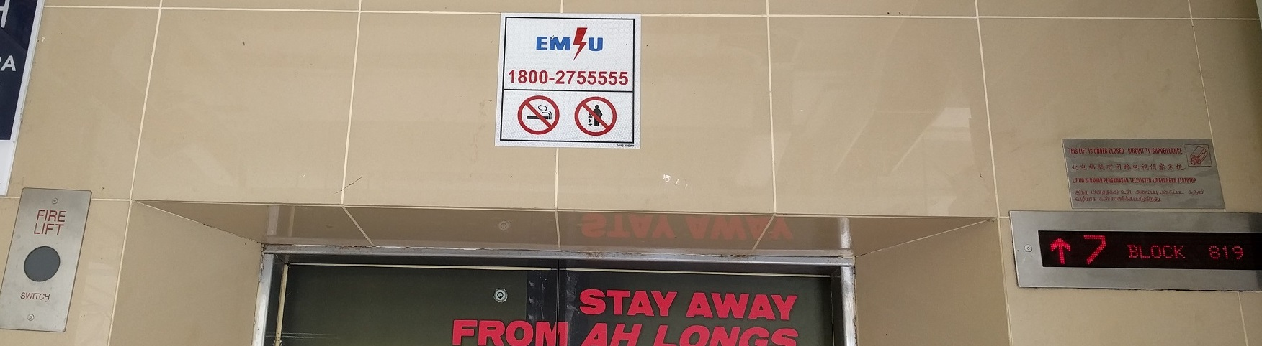
Problem 2: Inaccessible onsite breaker
Circuit breaker inside locked electrical room
Call Essential Maintenance Service Unit (EMSU) to unlock
30-60 mins response time

Slide 15
Problem 3: Inconvenience of breaker trip
Breaker trips affect the work of others eg. Sewing machine

Slide 16
Solution for RCCB earth-leakage trips
Jurong
Tampines
Increased safety due to more sensitive 10mA trip rating
Isolates earth trips to this device, onsite breaker RCCB does not trip
Demo video: https://www.youtube.com/watch?v=h-DokWP5Kic

Slide 17
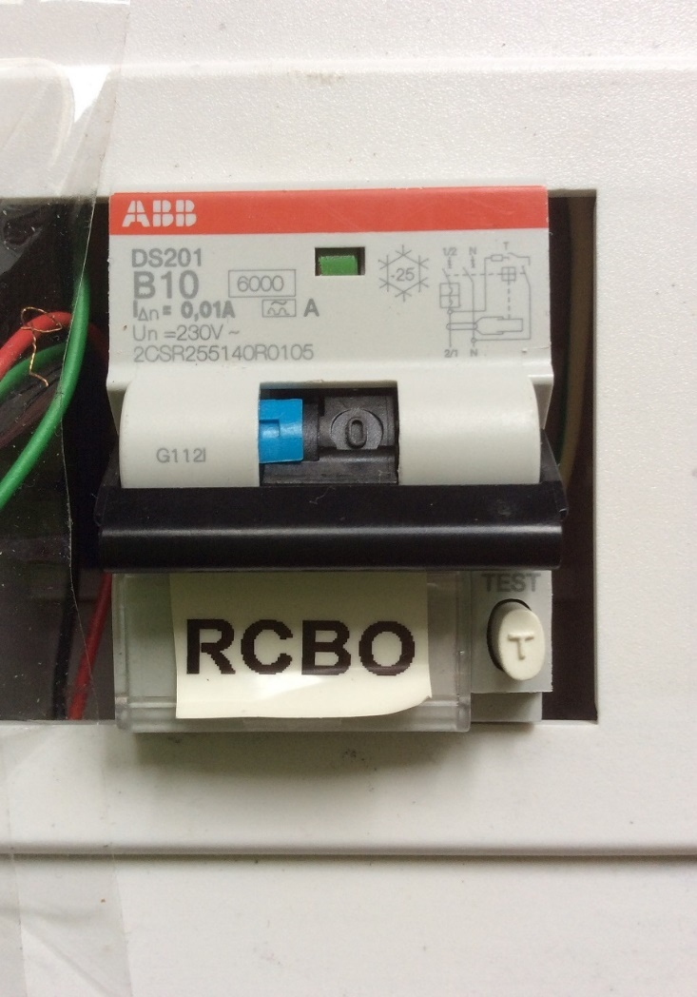
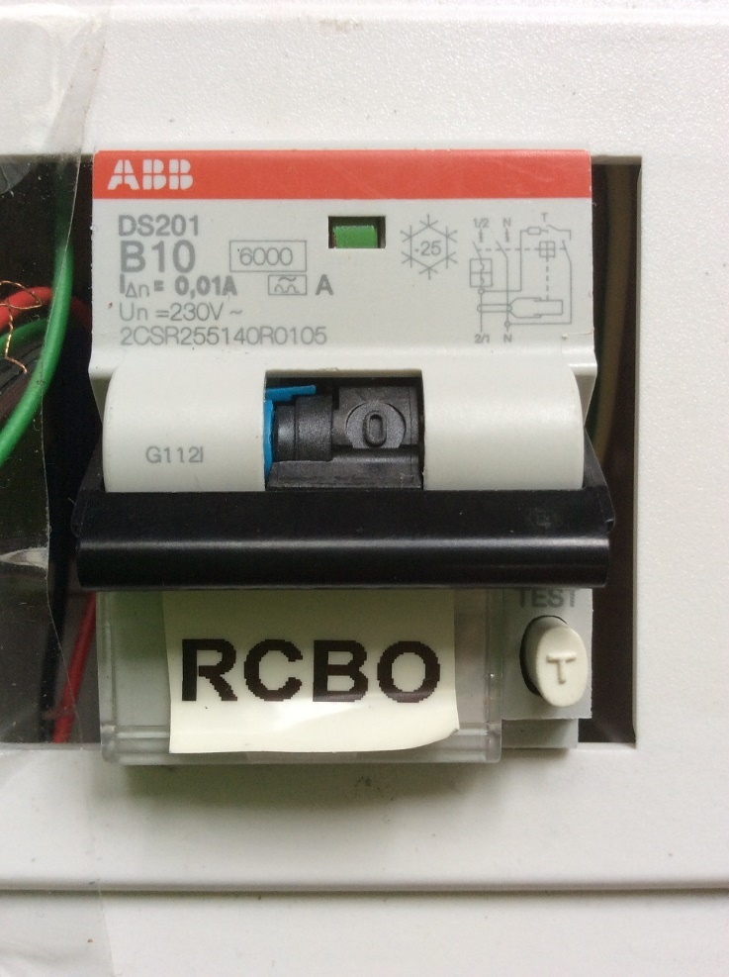
RCBO trip status + Demo
Earth trip: Switch and blue tab is down
Overload trip: Only switch is down

Slide 18
Solution for MCB short-circuit trips
Jurong
Tampines
Isolates short-circuits to this device, onsite breaker MCB should trip lesser
Connect DOWNSTREAM to RCBO

Slide 19
Solution to prevent MCB trip (Demo)
Video URL: https://www.youtube.com/watch?v=VpU6cOnxy0s
20 seconds startup time to let current measurement settle. Notice the left relay is kept off till startup is done.
Turn on a lamp: There is a 1 second delay between turning on the lamp and the second relay being turned on. Also notice the display backlight turns on and the buzzer buzzes once.
Turn off the lamp: The display backlight turns off immediately and the buzzer buzzes twice.
Repeat steps 2 and 3 for the hair dryer. Notice the motor sound is lower during the 1 second period.
Short circuit with a cable with its live and neutral pins shorted. The moment the switch is turned on, the device cuts off power to the outgoing socket. The buzzer also buzzes for a long 2 seconds. Notice the onsite MCB in the room did not trip as the device is still on.
Reset the device with just a simple button press.

Slide 20
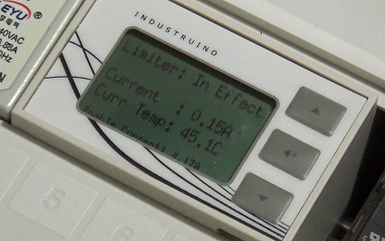
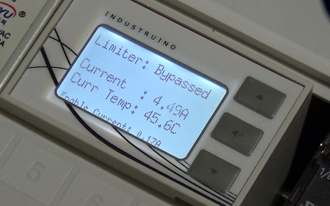
How to use it?
Make sure LCD backlight is off
Plug in appliance and turn on.
Short circuit detection mode
After one second, limiter will be bypassed. Buzzer sounds once
If short circuit happens, power cutoff and buzzer sounds for 3s
Turn off appliance, buzzer sounds twice and LCD backlight turns off

Slide 21
Test for Earth Leakage without tripping
anti-trip-earth-leakage-detector
Shows blue LED on earth fault without breaker trip
Does not interrupt the work of others
Preserves lifespan of RCBO
Familiarise with usage instructions beforehand
Demo video: https://www.youtube.com/watch?v=tSpie7baYFM

Slide 22
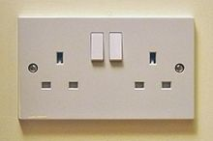
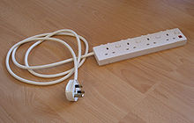
RK circuit breaker setup
Short circuit limiter
RK RCBO
Onsite socket
Extension bar
Anti-trip-earth-leakage-detector

Slide 23
Questions before the case study?

Slide 24
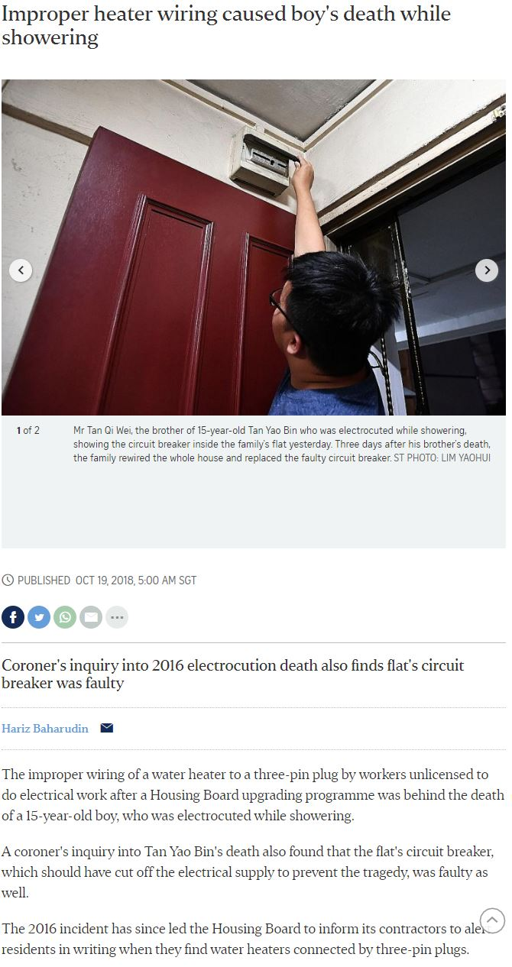
Case study: Improper heater wiring
What happened?
In 2016, a 15-year-old boy was electrocuted while using the water heater.
Failures drawn from coroner inquiry
Loose Earth and Neutral Wires in 13A plug
Neutral and Earth cables fused together
Faulty circuit breaker
Wired 13A single-pole switch socket instead of 20A line with double-pole switch
How did the failures lead to death?
https://www.straitstimes.com/singapore/improper-heater-wiring-caused-boys-death-while-showering
https://www.straitstimes.com/singapore/circuit-breaker-could-be-a-lifesaver

Slide 25
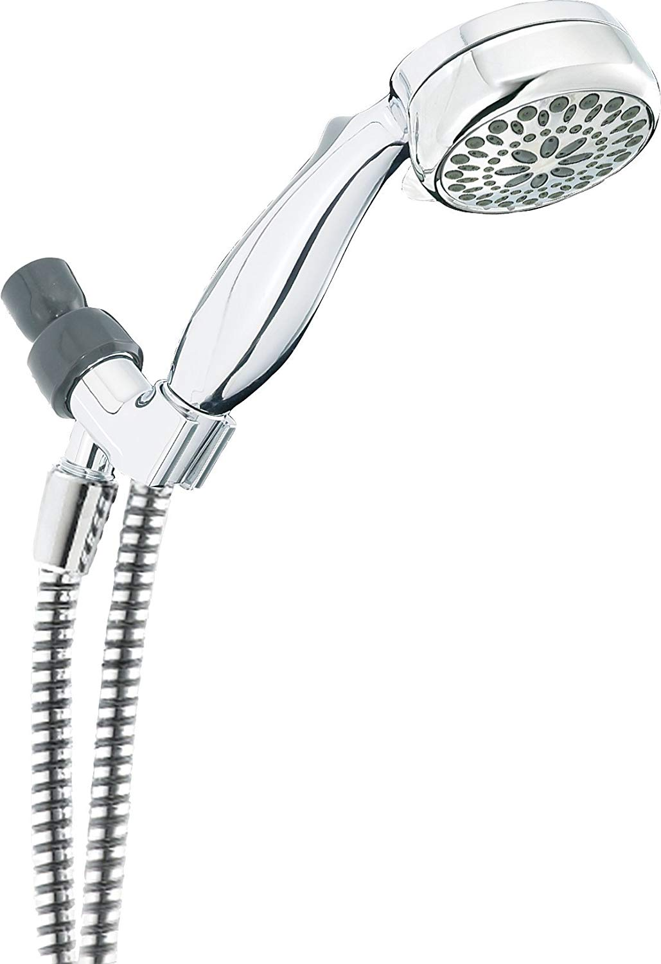
Failures drawn from coroner inquiry
Mains Live
Heater
RCCB
MCB
Fuse
230V
AC ~
Mains Neutral
Mains Earth
Earth
Loose Earth and Neutral Wires in 13A plug
Neutral and Earth cables fused together
Faulty circuit breaker
Wired 13A single-pole switch socket instead of 20A line double-pole switch

Slide 26
Path of current
Mains Live
Heater
RCCB
MCB
Fuse
230V
AC ~
Mains Neutral
Mains Earth
Earth
Neutral-Earth connection causes human body to be a possible return path
If RCCB is working, it will have tripped now.
Loose Earth and Neutral wires intermittently prevent return path of current
Faulty RCCB did not trip on imbalance between Live and Neutral during shock

Slide 27
What should you do?
Test RCCB monthly
Check if heater needs more than 13A-rated lines
Make sure wires can carry required current
Circuit breaker value must match
“Electrical work, whether at home or the office, should be carried out or supervised by a Licensed Electrical Worker (LEW).
https://www.ema.gov.sg/Hiring_Licensed_Electrical_Workers.aspx
Electricity Act: Part 82.—(1) Subject to subsection (2), no person shall —
(a) carry out or caused to be carried out any electrical work, unless he holds a valid electrical worker licence;
(b) advertise or otherwise holds himself out as an electrical worker, or as a licensed electrical worker, or as a person competent or qualified by any written law to perform or carry out electrical work, unless he holds a valid electrical worker licence; or
(c) engage knowingly any person who is not a licensed electrical worker to carry out any electrical work.
https://sso.agc.gov.sg/Act/EA2001?TransactionDate=20021129235959#pr82-
“Your flat’s electrical wiring has a limited lifespan. The estimated average lifespan of a PVC electrical cable is approximately 25 years. You are advised to replace the electrical wiring in your flat when its lifespan is over or when its condition has deteriorated.”
https://www.hdb.gov.sg/cs/infoweb/residential/living-in-an-hdb-flat/home-maintenance/electrical-accessories-and-wiring

Slide 28
Questions?
By: Yeo Kheng Meng (yeokm1@gmail.com)
https://github.com/yeokm1/repair-kopitiam-training-and-equipment
http://yeokhengmeng.com/2016/05/repair-kopitiam-speciality-electrical-tools/
http://yeokhengmeng.com/2017/07/repair-kopitiam-specialty-electrical-tools-part-2-short-circuit-limiter/

Slide 29
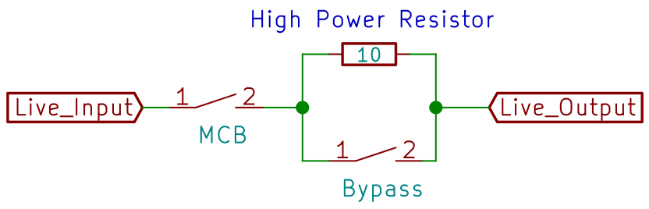
Behaviour State 0
MCB Relay
Bypass Relay
10-ohm resistor

Slide 30
Behaviour State 1
MCB Relay Closed
Bypass Relay Open

Slide 31
Behaviour State 2a
Appliance connected and 1 second of no short circuit
Bypass Relay closes -> Full current
If appliance turns off, go back to State 0

Slide 32
Behaviour State 2b
If short circuit happens, MCB relay opens
MCB relay closes only if user resets the system

Slide 33
System weakness
Short Circuit after Resistor has been bypassed
Multiple downstream appliances

Slide 34
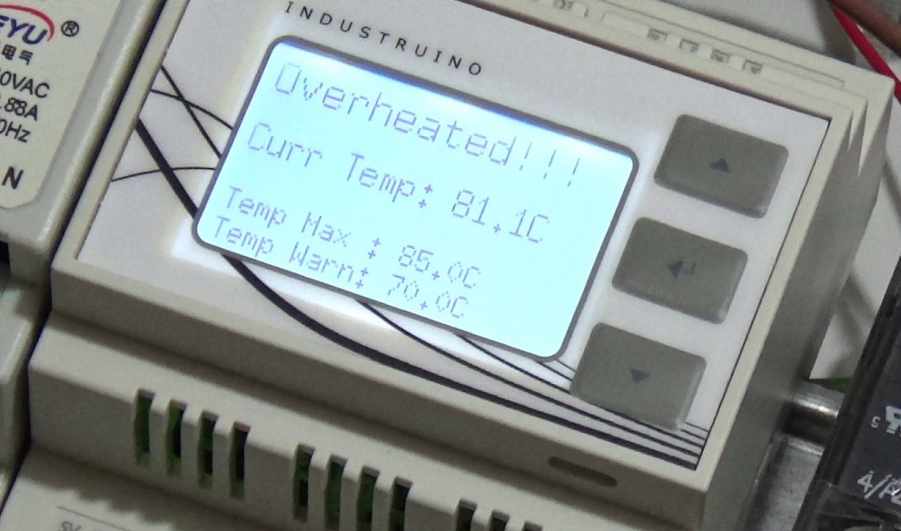
Resistor Overheat Alert
70°C buzzer/blink warning
85°C function ceased till temperature < 70°C
Video URL: https://www.youtube.com/watch?v=O4qB3WehqlA
Should not happen under normal cases

Slide 35
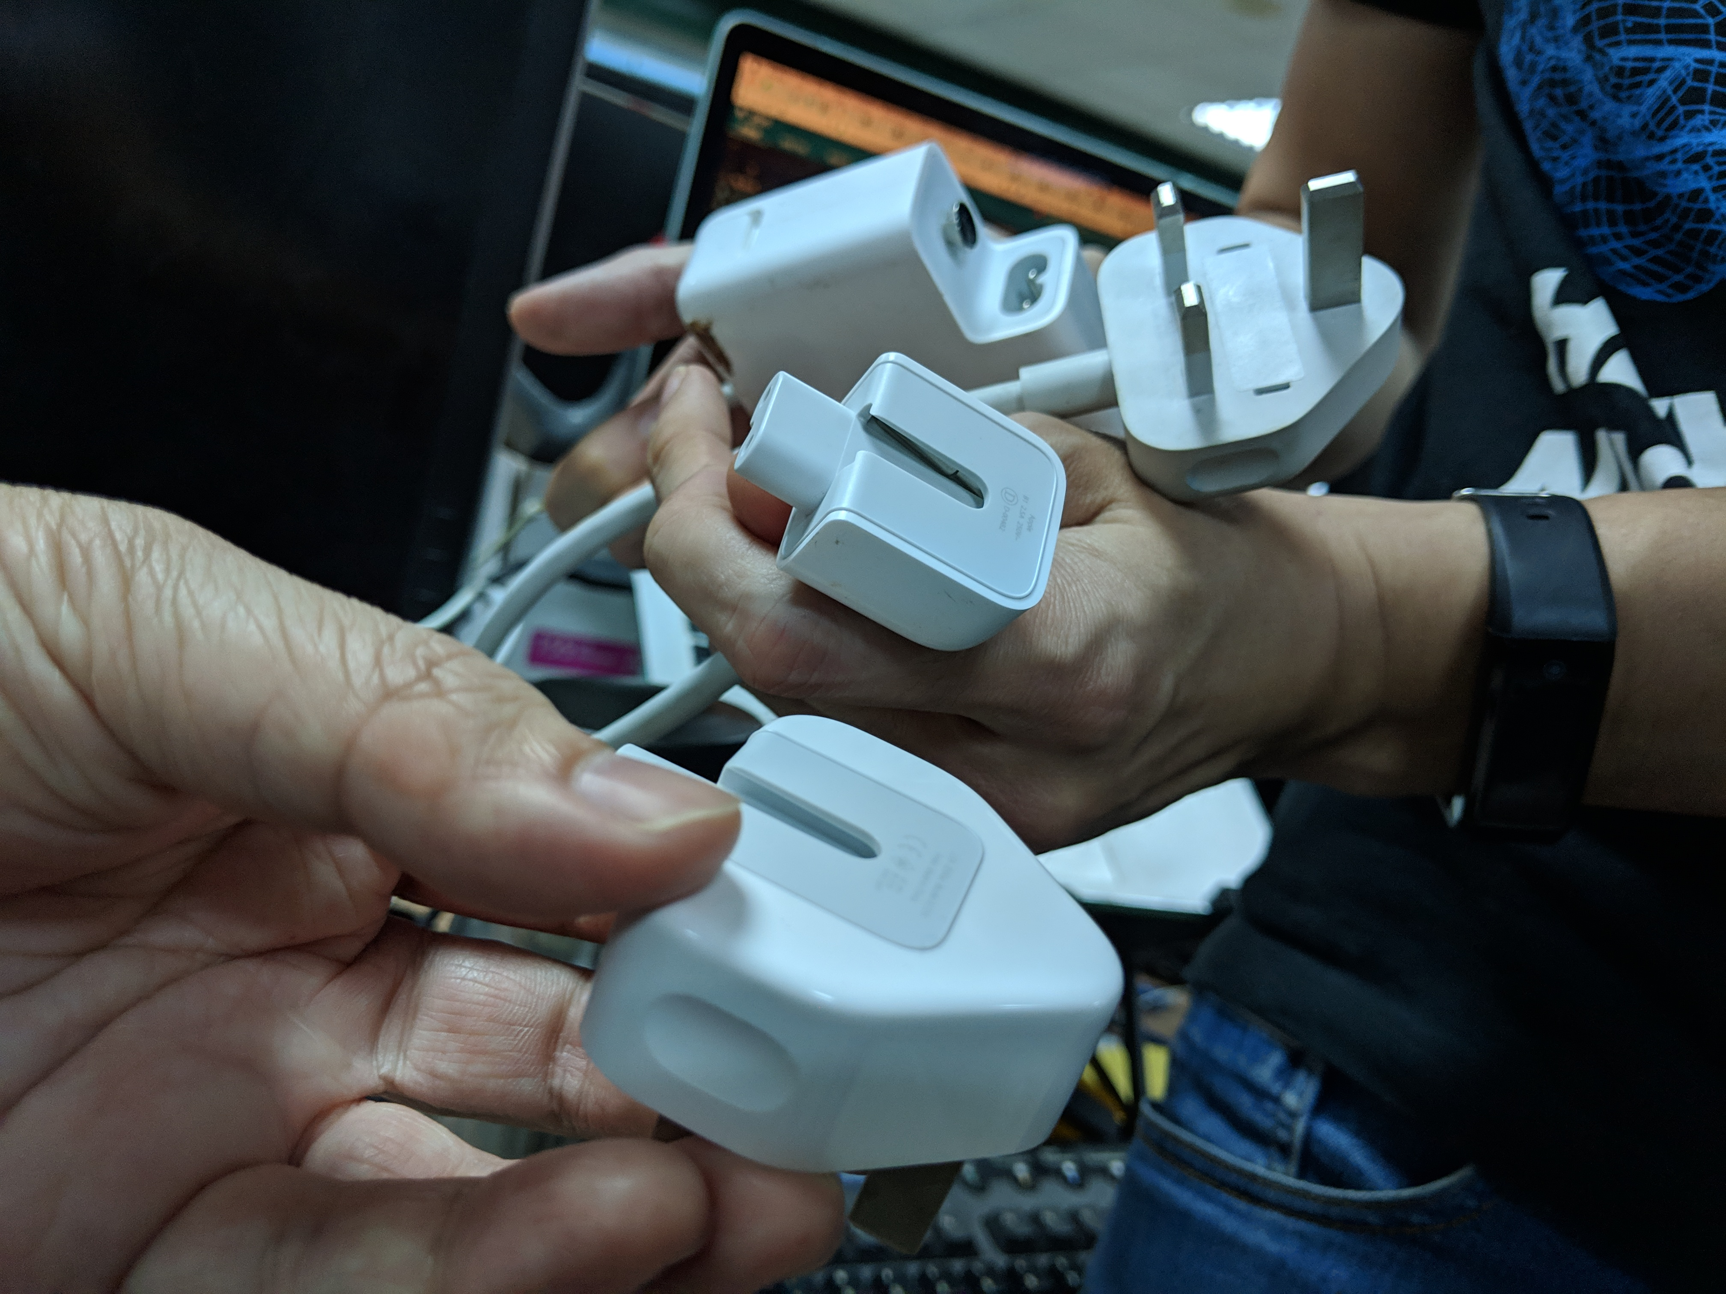
Why some Macbooks have static feeling?
Mac Power Adapter
Earth pin is the circular knob
Power Adapter Extension cable with Plug Head
Silver Earth Connection is available to mate with the circular knob of power brick
Power Adapter Plug Head
No Earth Connection is available

